Slide 1
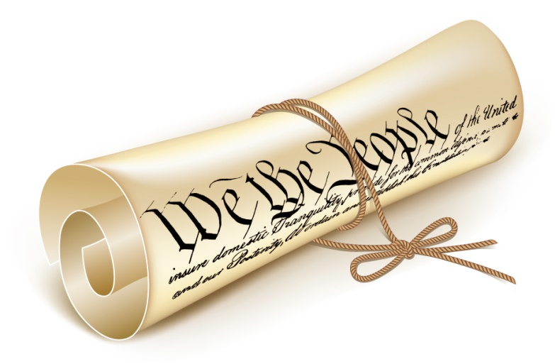
CONSTITUTION DAY
September 17, 2014
2020

Slide 2
history
The Constitution of the United States was signed on
September 17, 1787
http://www.constitutionday.com/index.html

Slide 3
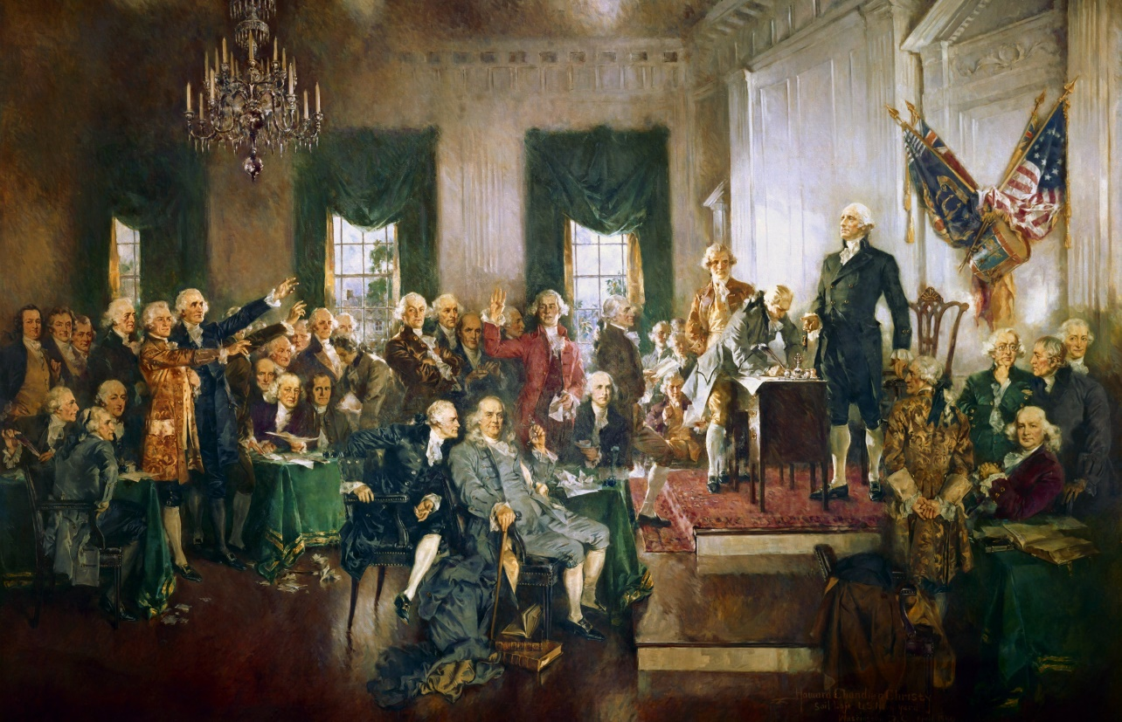
History
The Constitution was signed by 39 delegates
http://www.constitutionday.com/index.html

Slide 4
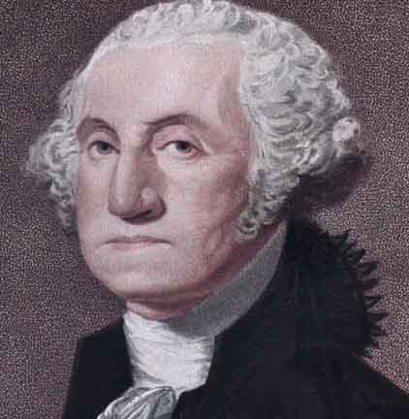
history
The names of the 39 delegates
William S. Johnson
Roger Sherman
Richard Bassett
Gunning Bedford, Jr.
Jacob Broom
John Dickinson
George Read
Abraham Baldwin
William Few
Daniel Carroll
Daniel Jenifer of St. Thomas
James McHenry
Nathaniel Gorham
Rufus King
Nicholas Gilman
John Langdon
David Brearly
Jonathan Dayton
William Livingston
William Paterson
Alexander Hamilton
William Blount
Richard D. Spaight
Hugh Williamson
George Clymer
Thomas Fitzsimons
Benjamin Franklin
Jared Ingersoll
Thomas Mifflin
Gouverneur Morris
Robert Morris
James Wilson
Pierce Butler
Charles Pinckney
Charles Cotesworth Pinckney
John Rutledge
John Blair
James Madison
George Washington
http://www.answers.com/Q/Who_signed_the_US_Constitution
http://www.biography.com/people/george-washington-9524786

Slide 5
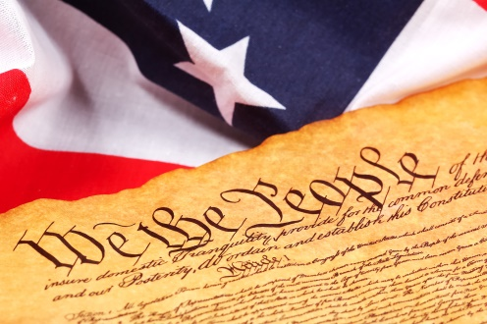
history
The Constitution starts with:
We the People of the United States, in Order to form a more perfect Union, establish Justice, insure domestic Tranquility, provide for the common defense, promote the general Welfare, and secure the Blessings of Liberty to ourselves and our Posterity, do ordain and establish this Constitution for the United States of America.
The Constitution consists of 7 Articles
http://www.constitutionday.com/the-constitution-text.html

Slide 6
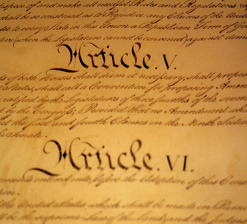
Articles
Article 1: Powers of Congress
Article 2: Responsibility of the Executive Branch
Article 3: Purpose of the Judicial Branch
Article 4: Responsibilities & Duties of State & Federal Government
Article 5: Constitutional changes by Amendment only
Article 6: Constitution is the highest law
Article 7: Explains how many states need to ratify the Constitution
http://kids.laws.com/articles-of-the-constitution

Slide 7
When Was the constitution signed?
September 17, 2014
September 17, 1887
September 17, 1787
September 17, 1789

Slide 8
Answer: When Was the constitution signed?
September 17, 1787

Slide 9
How many articles are there in the constitution?
8
7
6
9

Slide 10
Answer: How many articles are there in the constitution?
7

Slide 11
What line starts the Constitution?
We the Population
We the Students
We the Americans
We the People

Slide 12
ANSWER: What line starts the Constitution?
We the People

Slide 13
How many delegates signed the constitution?
40
41
39
38

Slide 14
ANSWER: How many delegates signed the constitution?
39

Slide 15
Which Article states that the constitution can only change by an amendment?
Article 1
Article 3
Article 6
Article 5

Slide 16
ANSWER: Which Article states that the constitution can only change by an amendment?
Article 5

Slide 17
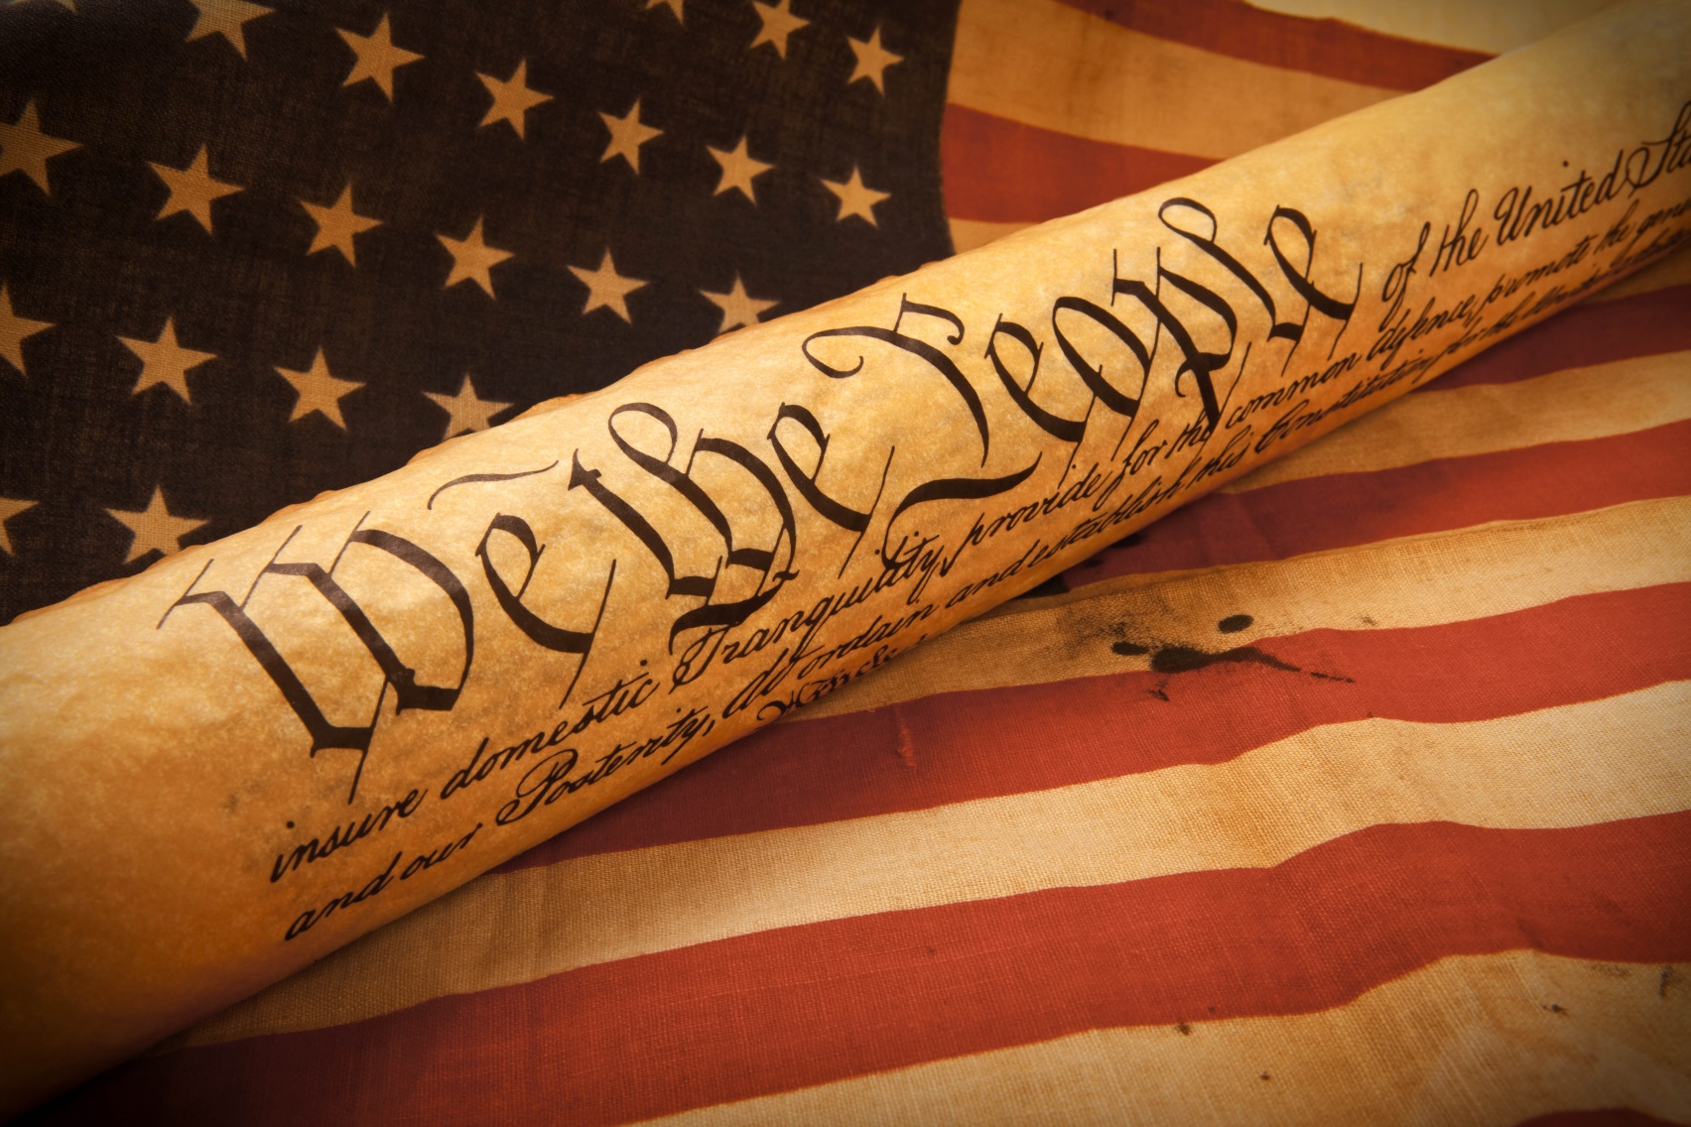
HAPPY CONSTITUION DAY!

